Slide 2
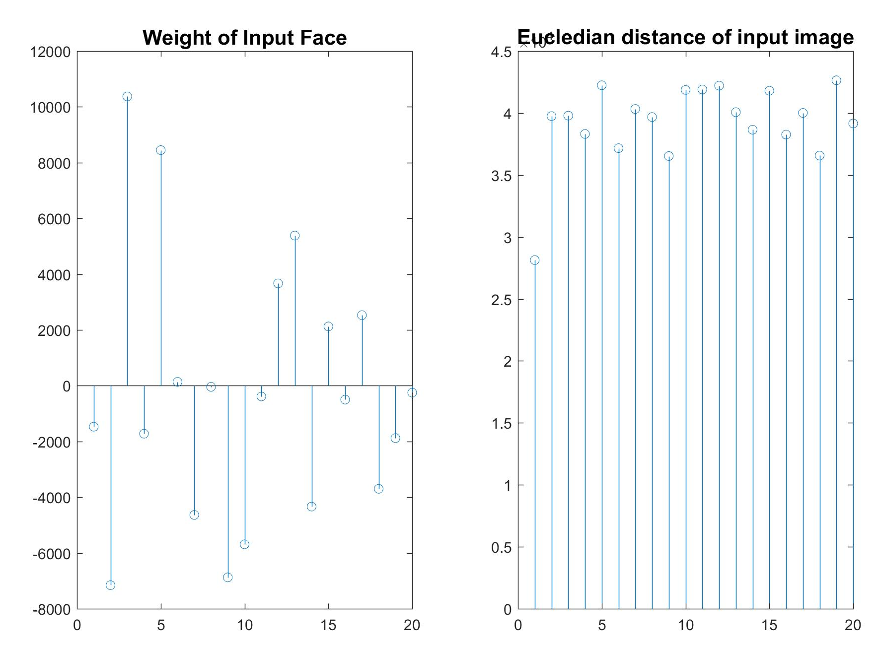
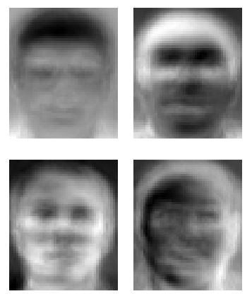
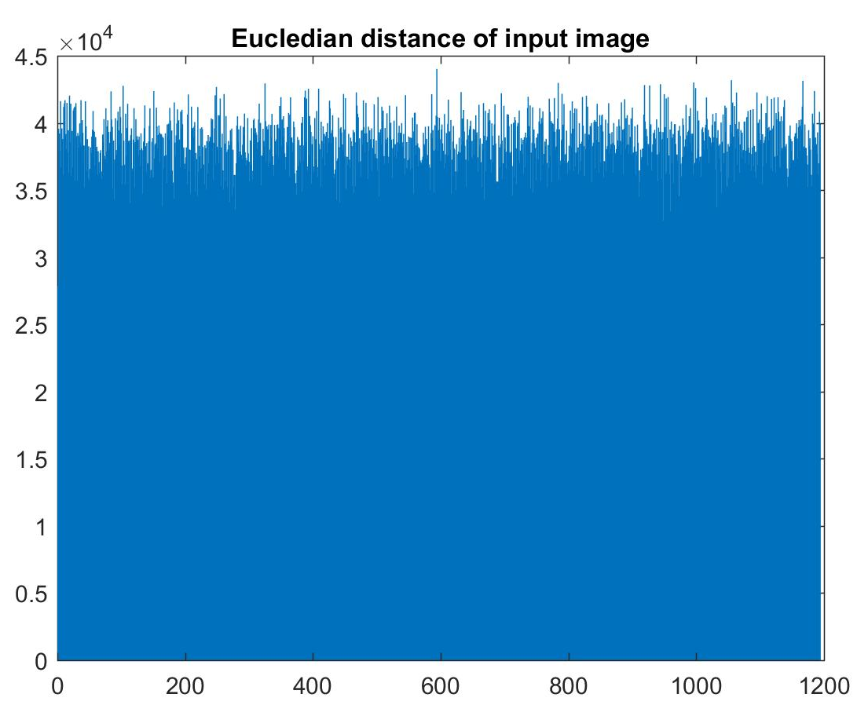
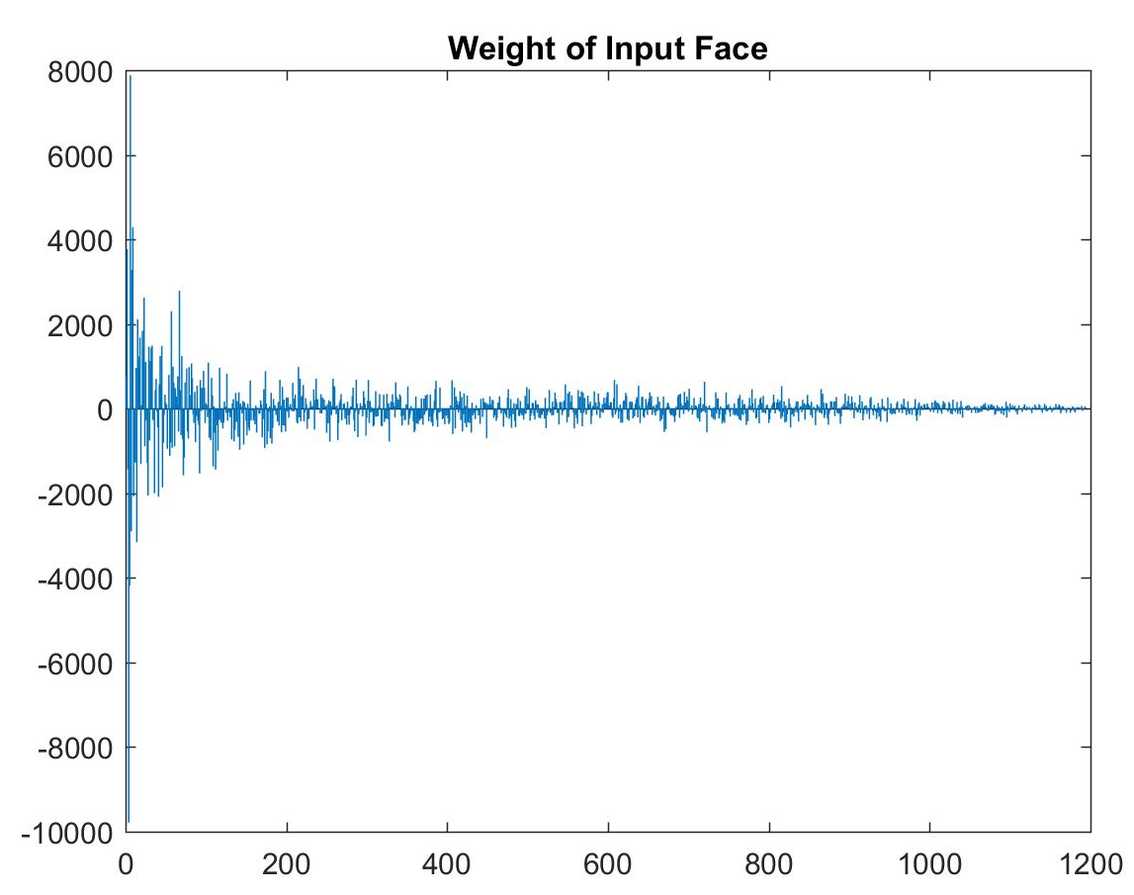
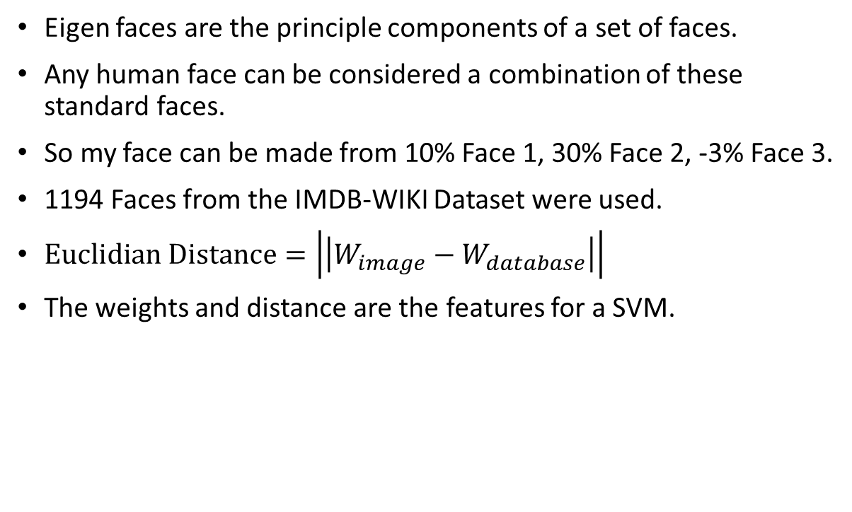
Eigen faces are the principle components of a set of faces.
Any human face can be considered a combination of these standard faces.
So my face can be made from 10% Face 1, 30% Face 2, -3% Face 3.
1194 Faces from the IMDB-WIKI Dataset were used.
$Euclidian Distance=\left|\left|W_{image}−W_{database}\right|\right|$
The weights and distance are the features for a SVM.
Examples of eigen faces

Slide 3
Eigen faces are

